Slide 1

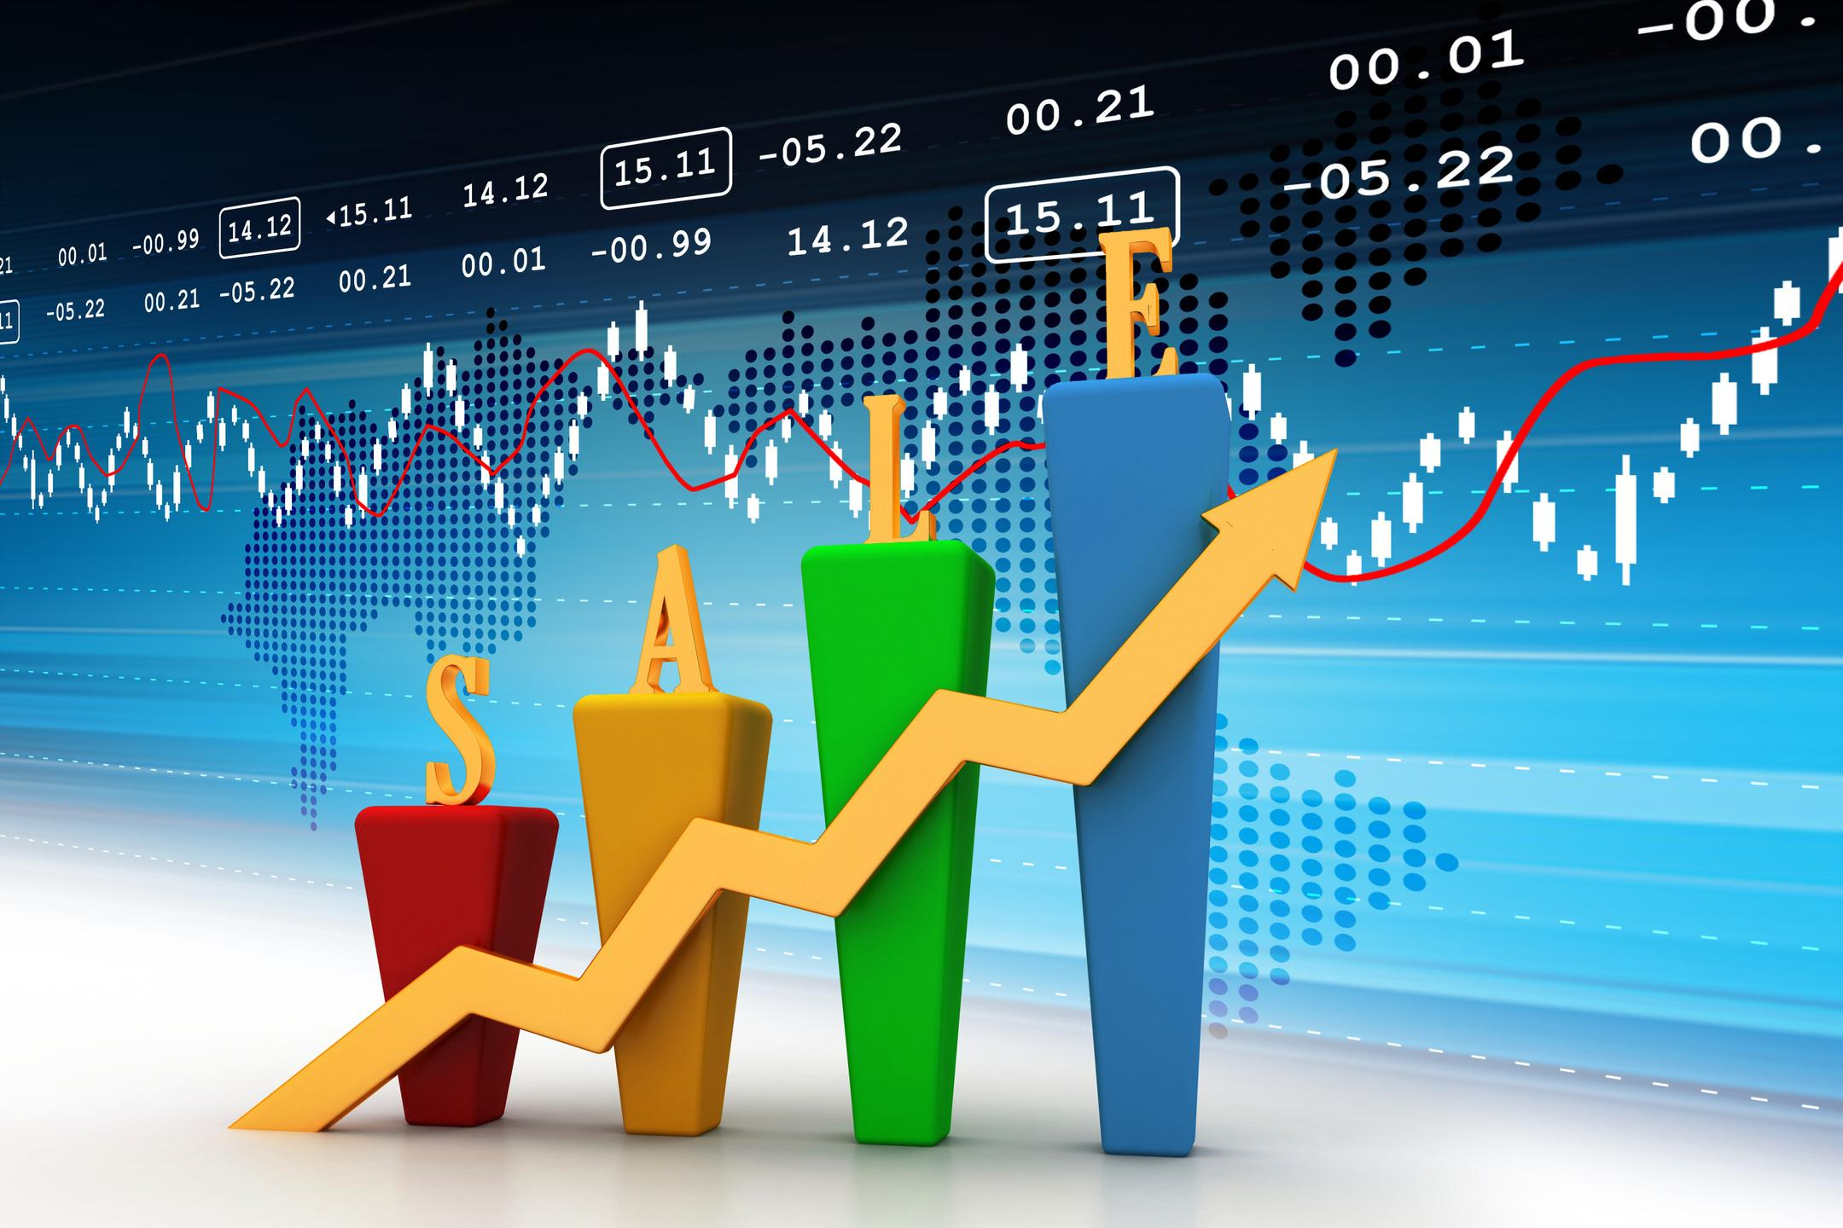
Sales Analytics Corp
Sales Performance Report
Monitoring Sales Progress in the FMCG Industry
[YOUR NAME]
Sales Manager at Sales Analytics Corp
1

Slide 2

Sales Performance Report Overview
This presentation covers key metrics for sales success
  Number of deal closures
  Average conversion time
  Total sales value
  Monthly performance trends
  Key performance indicators (KPIs)
SALES PERFORMANCE REPORT: FMCG INDUSTRY INSIGHTS

Slide 3
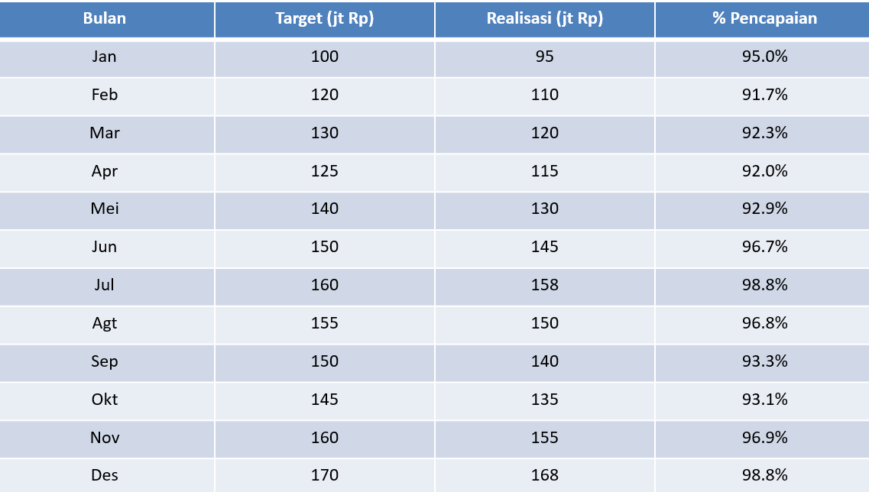
Monthly Sales Performance Overview: Metrics and Insights
This report evaluates sales progress for teams in the FMCG industry.
3

Slide 4


Understanding Deal Closures in Sales Performance
Tracking deal closures is crucial for measuring success. It helps in identifying trends and areas for improvement in the sales process.
Analyzing Average Conversion Time for Efficiency
Average conversion time indicates the efficiency of the sales funnel, allowing teams to optimize processes and improve overall performance.
KEY PERFORMANCE INDICATORS

Slide 5
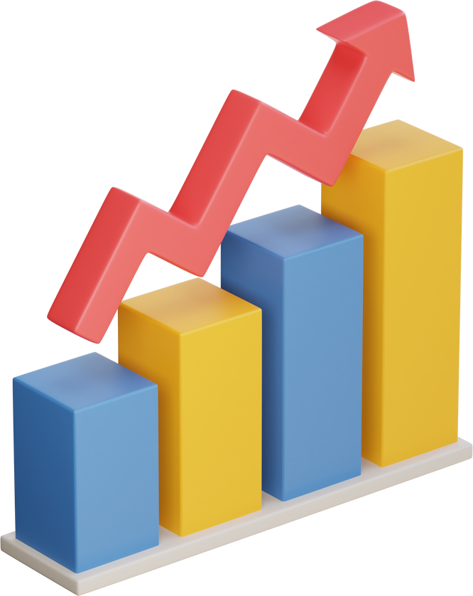

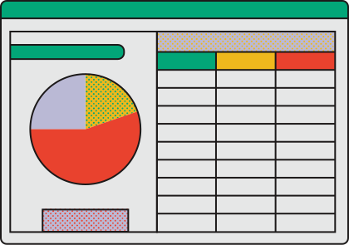
Monthly Deal Closures Comparison
This section compares this month's deal closures to those of the previous month, highlighting key changes.
Analyzing the trends in deal closures reveals important insights regarding our sales performance. This month, we observed a notable increase in closures, suggesting improvements in our sales strategies or market conditions that warrant further investigation.
5

Slide 6
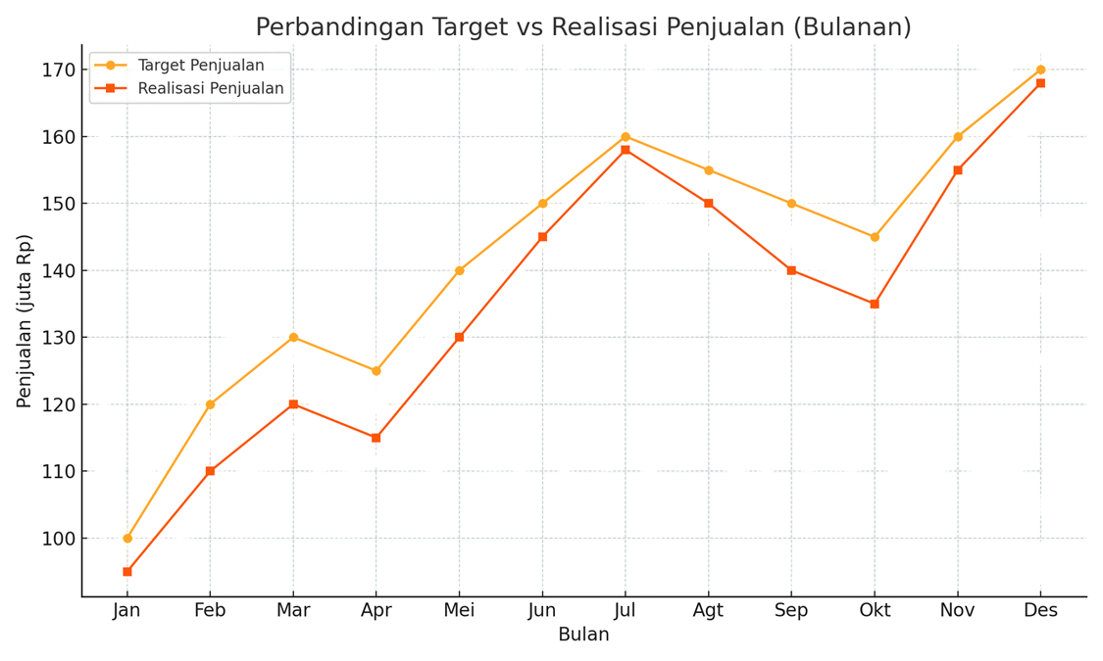
Total Sales Value Analysis
This chart illustrates the sales value breakdown across various product categories, providing insights into performance trends and helping identify areas for potential growth.
6

