Slide 1
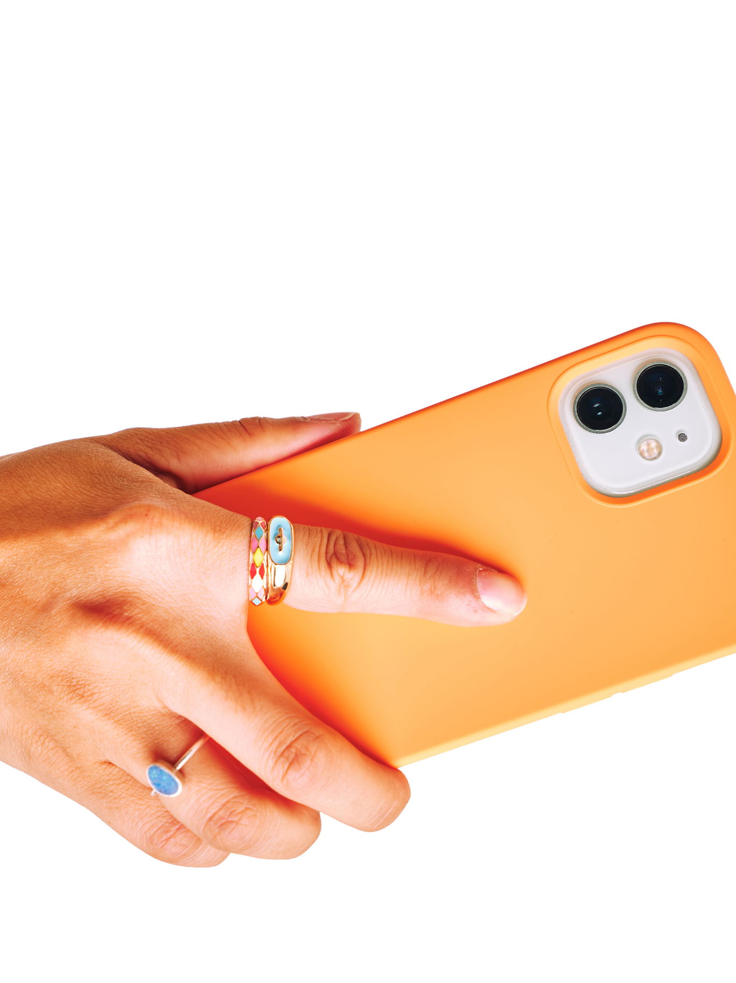
BRAND IMAGE
PRODUCT
DEMO
The Nudge 8 App

Slide 2

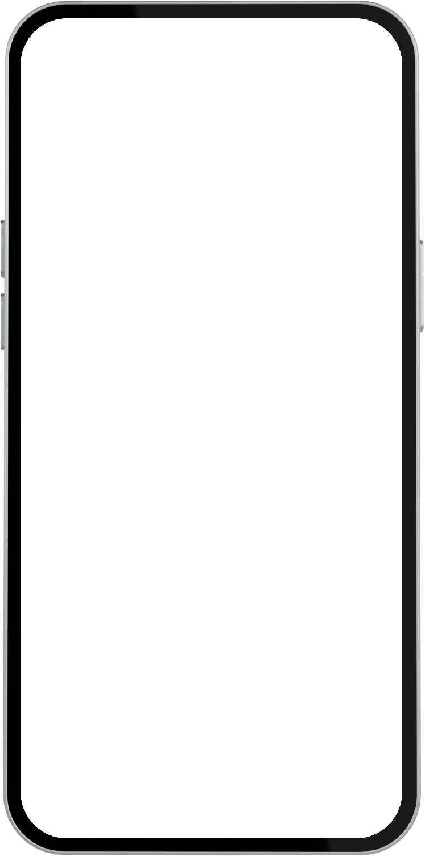



Slide 3



REIMAGINE
WORKPLACE
EFFICIENCY.
Find your favorite workplace tools in one place.
Defy limits with software that drives productivity
and enables your team to perform with ease. Create smart commands to streamline processes, gauge capacity, sync calendars, and more with Nudge8.

Slide 4



“Fewer processes in a fast-paced business environment used to be a dream. Now, it’s here to help take your brand to new heights.”
SIOMAN PUTRA
Chief Technology Officer

Slide 5
BUILT
to support your brand growth
DESIGNED
for improved operational efficiency
SUITED
for swiftly changing business needs

Slide 6
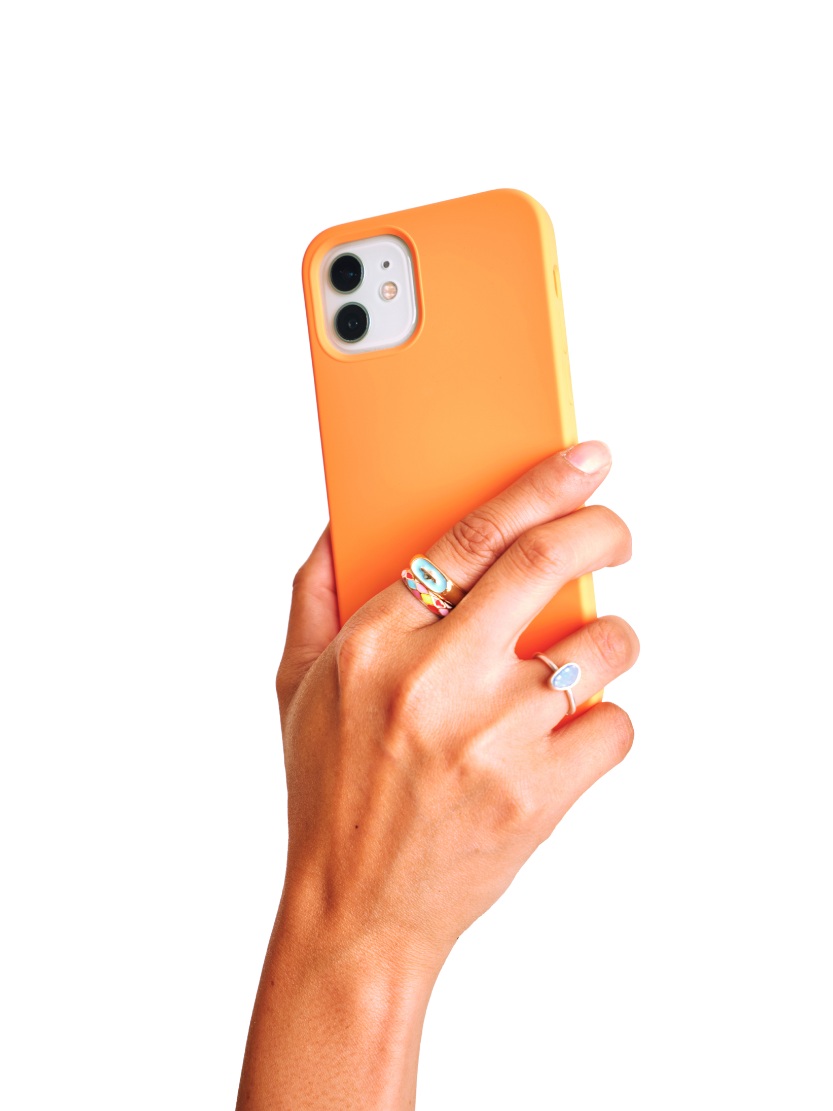
HOW TO USE

Slide 7


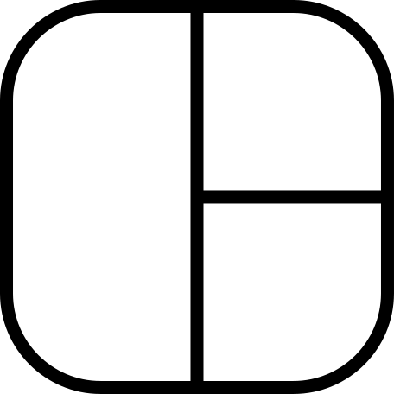




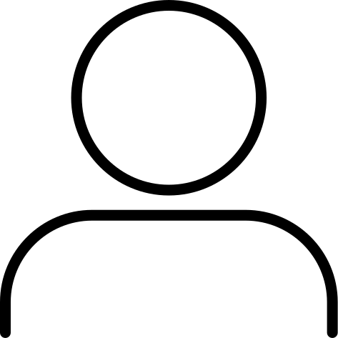

SELECT
the project management features that are relevant to your daily operations.
Drag and drop a photo or video to create a mockup. Select yours from the uploads tab, drag, and then drop inside the frame!

Slide 8
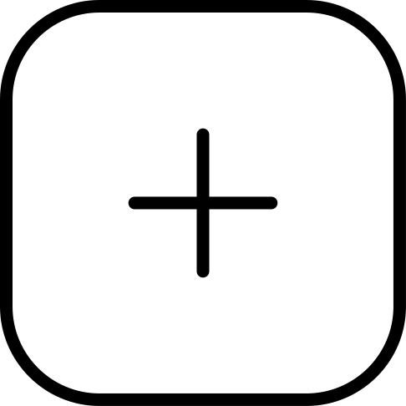



CUSTOMIZE
timelines, commands, labels and notifications.
Drag and drop a photo or video to create a mockup. Select yours from the uploads tab, drag, and then drop inside the frame!

Slide 9
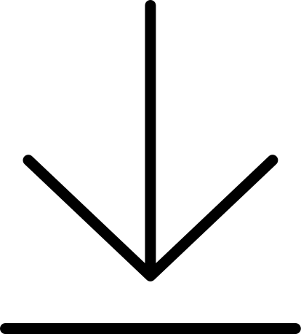

EXPLORE
Explore the add, remove, or edit project
features and export data (as needed) for that added layer of security and documentation.
Drag and drop a photo or video to create a mockup. Select yours from the uploads tab, drag, and then drop inside the frame!

Slide 10
WORKPLACE
Efficiency
Reimagined.
Discover how Nudge8 can supercharge your workflows, productivity, and team performance.

Slide 11
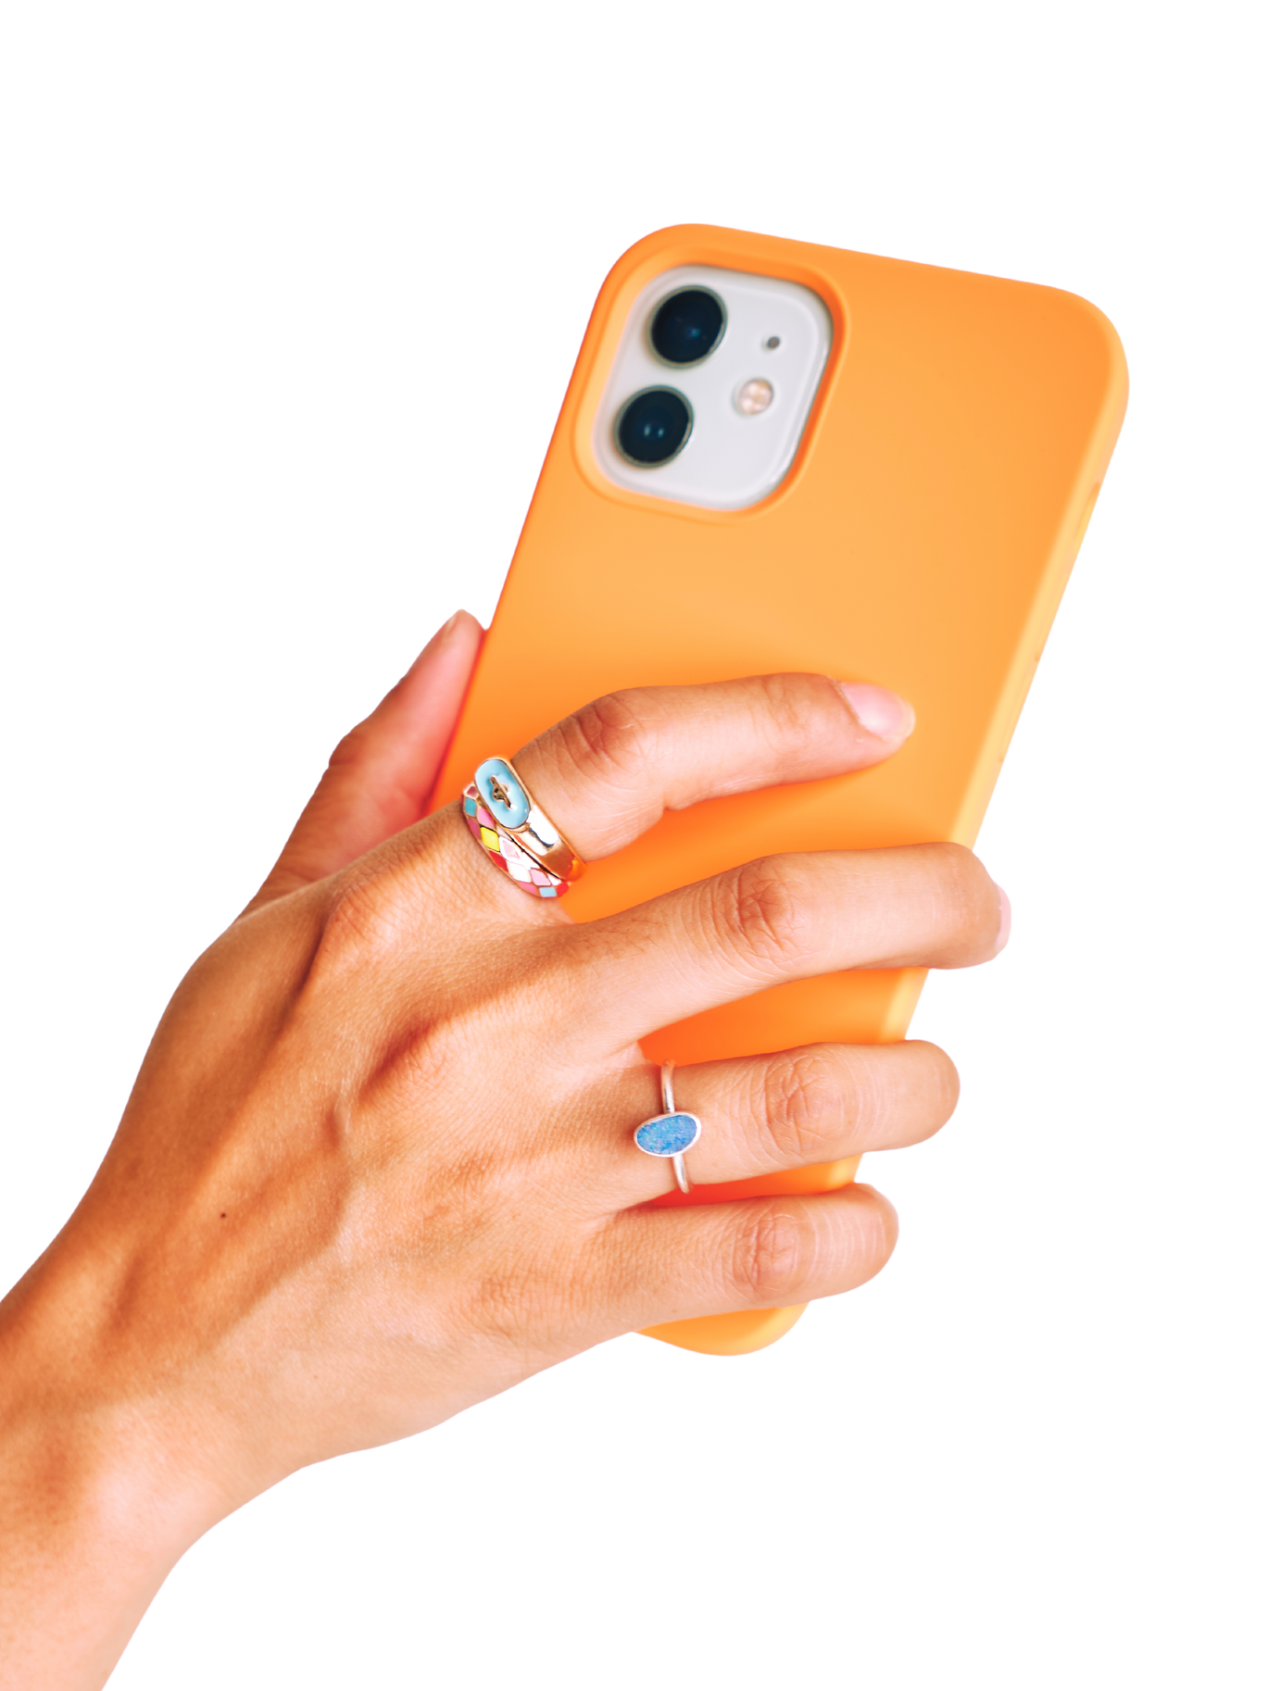
QUESTIONS?
Get in touch with us.

