Slide 1



Brand image
SALES
REPORT
Analyzing sales performance in a certain period, helping companies measure target achievement and sales strategies.

Slide 2


Introduction
Sales Report
Introduction Sales Report is the initial part of the sales report which provides a general overview of the contents of the report. This section usually includes the purpose of the report, the time period covered, a summary of key sales data, and any relevant context or background. The goal is to give readers an initial understanding of what they will find in the report and why the information is important.

Slide 3



Overview of
Sales Performance
Sales Performance Overview is a part of the sales report that provides an overview of sales performance during a certain period. This section usually includes:
Total Sales Summary
Comparison with Previous Periods
Achievement of Target
Trend Analysis

Slide 4

Total Sales Summary
Total sales achieved in that period.
Comparison with Previous Periods
Comparison of current sales performance with previous periods (month, quarter, year).
Achievement of Target
How close sales are meeting or exceeding set targets.
Trend Analysis
Visible sales trends, such as an increase or decrease in sales of a particular product or in a particular region.

Slide 5
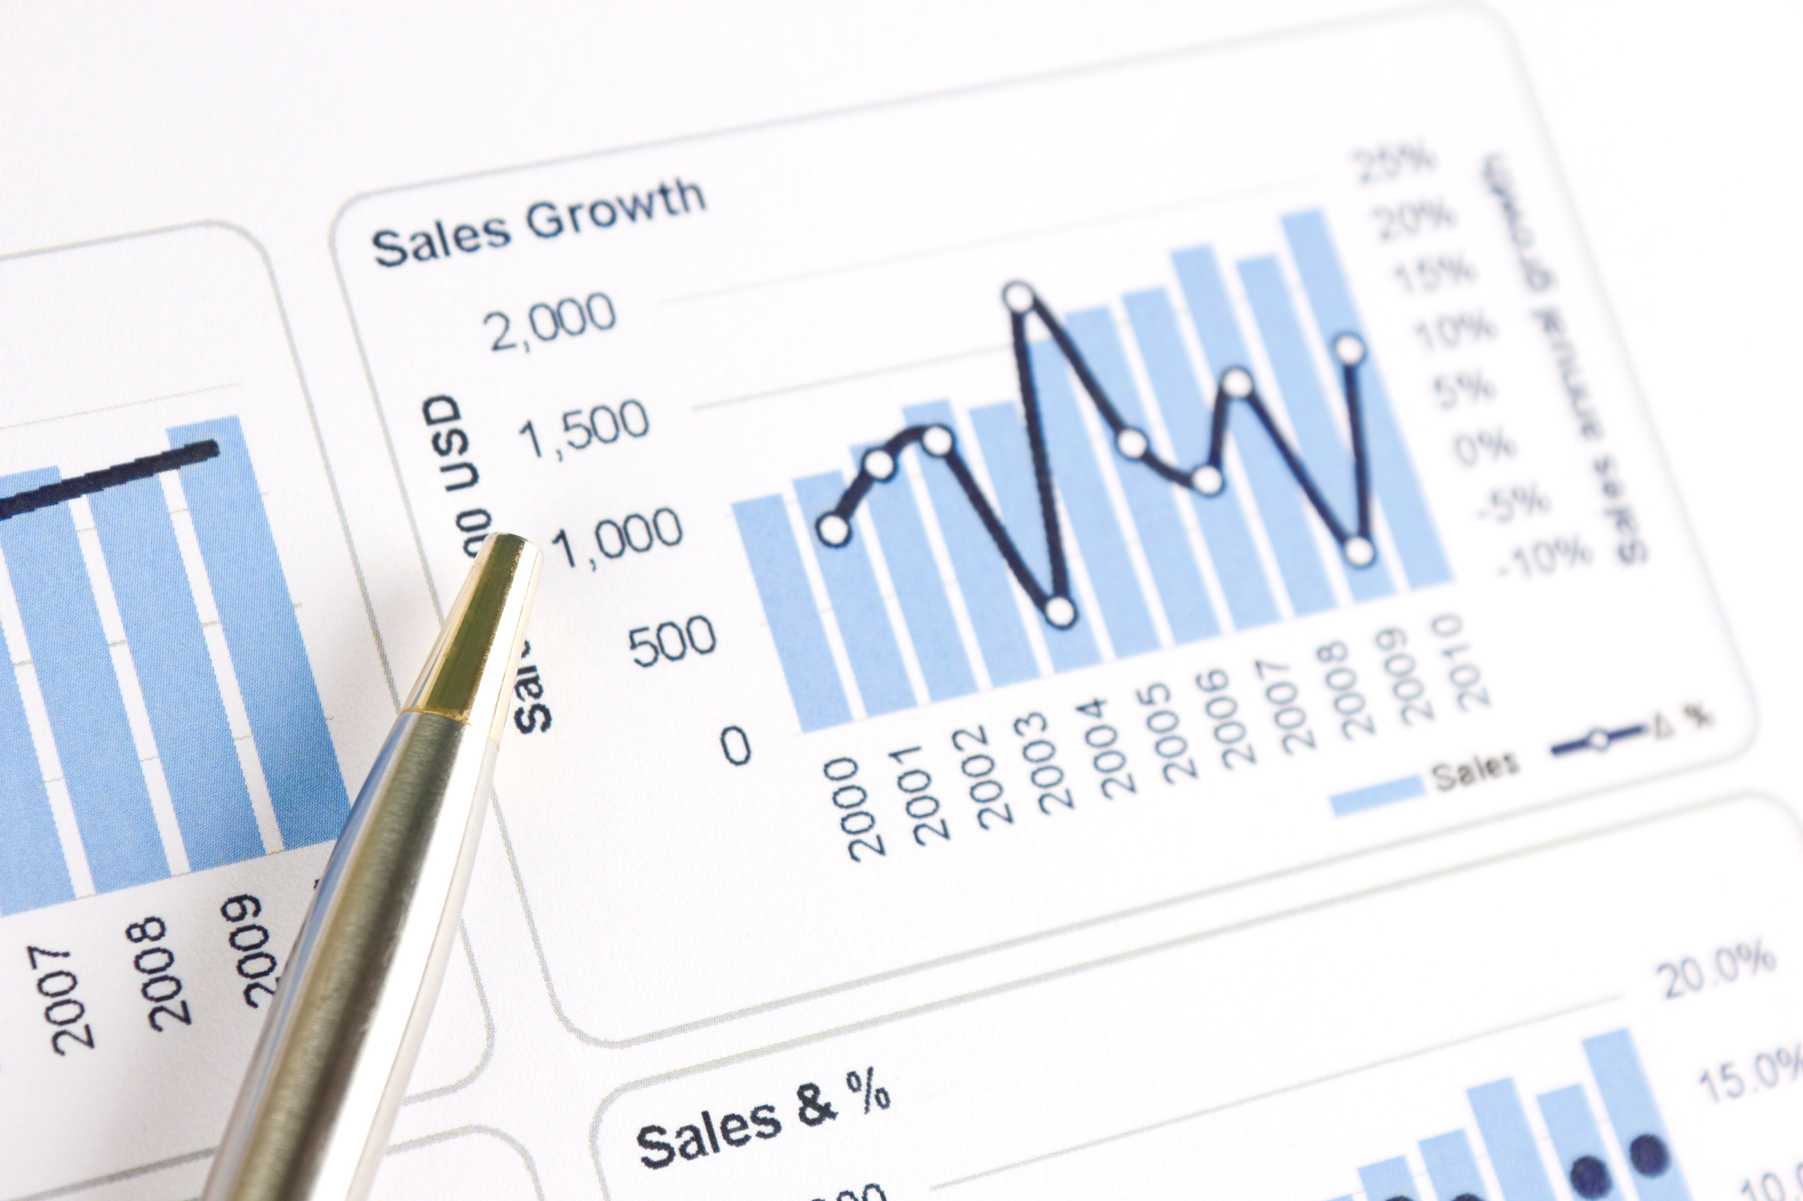
Sales
by Region
Sales by Region is a part of the sales report that breaks down and analyzes sales data based on specific geographic regions. This section includes:
Total Sales per Region
Inter-Region Comparison
Sales Trends by Region
Regional Contribution to Total Sales

Slide 6


Total Sales per Region
Total sales achieved in each specific region or area.
Inter-Region Comparison
Compare sales performance across regions to identify high or low performing areas.
Sales Trends by Region
Analyze sales trends in each region to see growth or decline.
Regional Contribution to Total Sales
Determines the contribution of each region to the company's total sales.

Slide 7

Sales by
Product Line
Sales by Product Line is a part of the sales report that breaks down and analyzes sales data based on certain categories or product types. This section includes:
Total Sales per Product Line
Sales Trends per Product Line
Comparison Between Product Lines
Product Line Contribution to Total Sales

Slide 8




Comparison Between Product Lines
Product Line Contribution to Total Sales
Total Sales per Product Line
Sales Trends per Product Line
Total sales achieved by each product category.
Compares the sales performance of various product lines to identify high or low performing products.
Analyze sales trends in each product line to see patterns of growth or decline.
Determines the contribution of each product line to the company's total sales.

Slide 9
Sales Channels
Performance
Sales Channels Performance is a part of the sales report that analyzes the performance of various distribution channels used by the company to sell its products. This section includes:
Total Sales per Channel
Total Sales per Channel
Channel Performance Comparison
Costs and Profits per Channel
Sales Trends per Channel
Recommendations for Channel Optimization
Channel Contribution to Total Sales

Slide 10

Customer
Segmentation
Sales Channels Performance is a part of the sales report that analyzes the performance of various distribution channels used by the company to sell its products.
Demographics
Geographic
Psychographics
Behavioral

Slide 11

Demographics
Group customers by age, gender, income, education, marital status, etc.
Geographic
Group customers by geographic location such as country, city, or zip code.
Psychographics
Group customers based on lifestyle, personality, values, interests, and attitudes.
Behavioral
Group customers based on their behavior toward products or services, such as purchasing patterns, loyalty, product usage, and response to marketing campaigns.

Slide 12

Sales Trends
and Analysis
Sales Trends and Analysis is a part of a sales report that identifies and evaluates patterns and changes in a company's sales over a certain period of time. The goal is to provide insight into how sales change over time and what factors influence those changes.

Slide 13
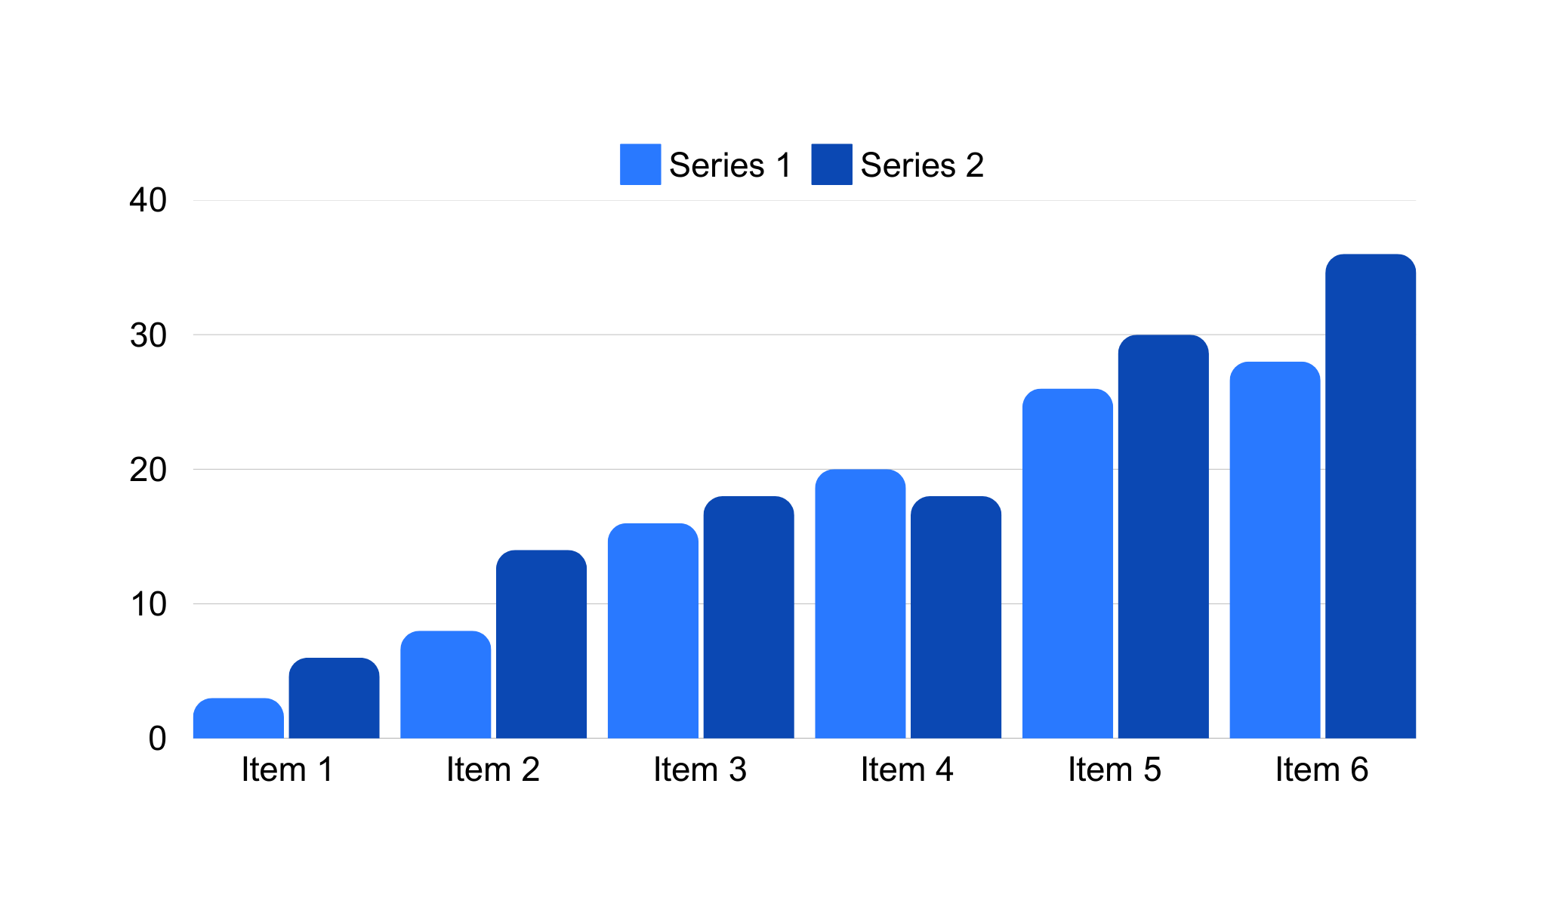

Slide 14

Marketing and
Sales Initiatives
Marketing and Sales Initiatives are strategies and actions designed and implemented by companies to increase sales, expand markets, and strengthen relationships with customers. These initiatives are often part of a broader business plan and include a variety of marketing and sales activities.

Slide 15





Brand Image
THANK
YOU
CONTACT US
Telephone:
Email:
Website:
Address:

