Slide 1


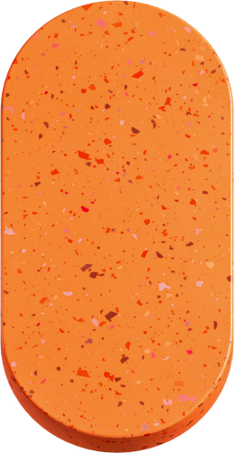
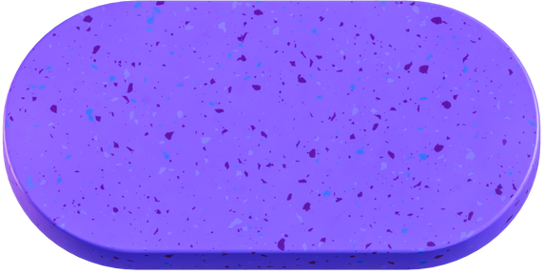
Brand inc
PITCH DECK
Digital Marketing Plan

Slide 2



Who We Are?
Small businesses find it difficult to raise money for the business. A pitch deck gives the investors a combined and short picture of the business.
Annual Revenue
User Growth
Customers
Your Annual revenue will come here.
Your user growth for last month.
Number of customer

Slide 3
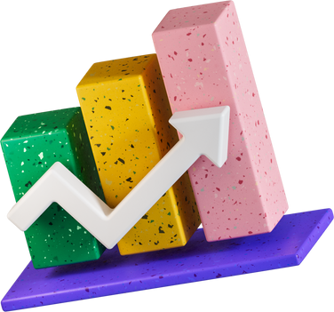
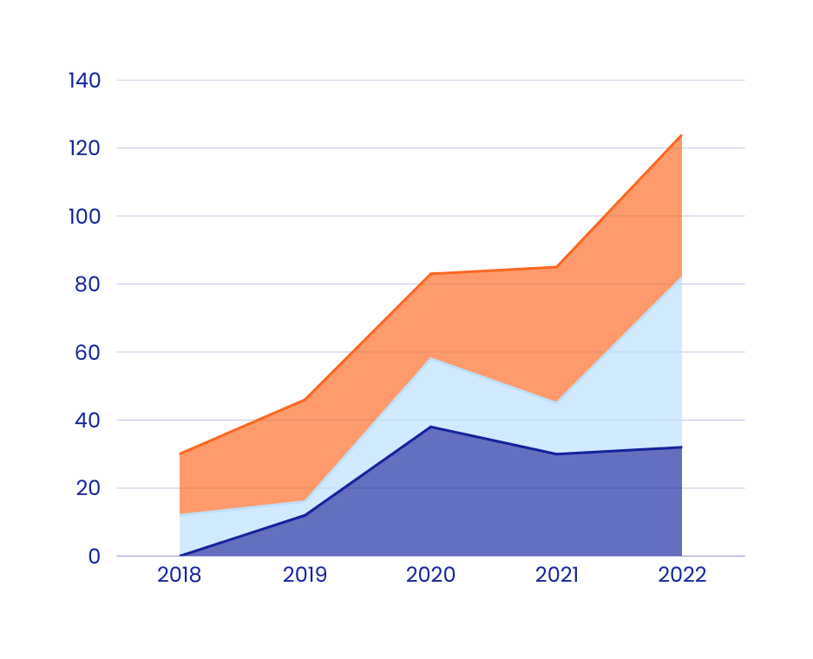
The Problem
DESCRIBE THE MAIN OBJECTIVE OF YOUR COMPANY
Describe what your business does and what your objective is. What kind of problems do you solve for people?

Slide 4
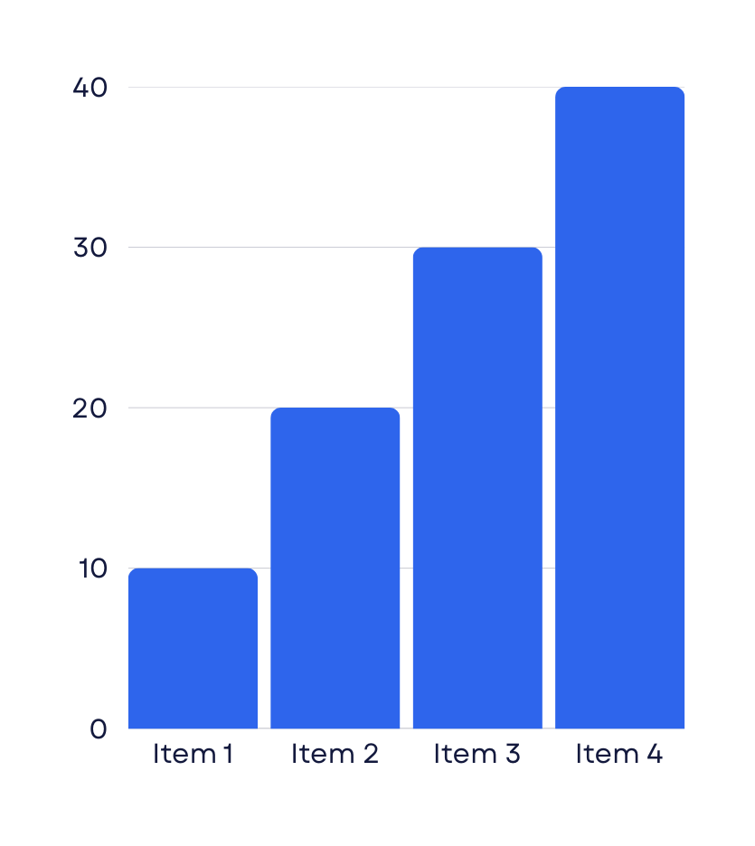

Better Solution
Social media marketing
Different social media platforms to market the products.
Digital marketing
Using a different search engine and website to market products to the audience.

Slide 5
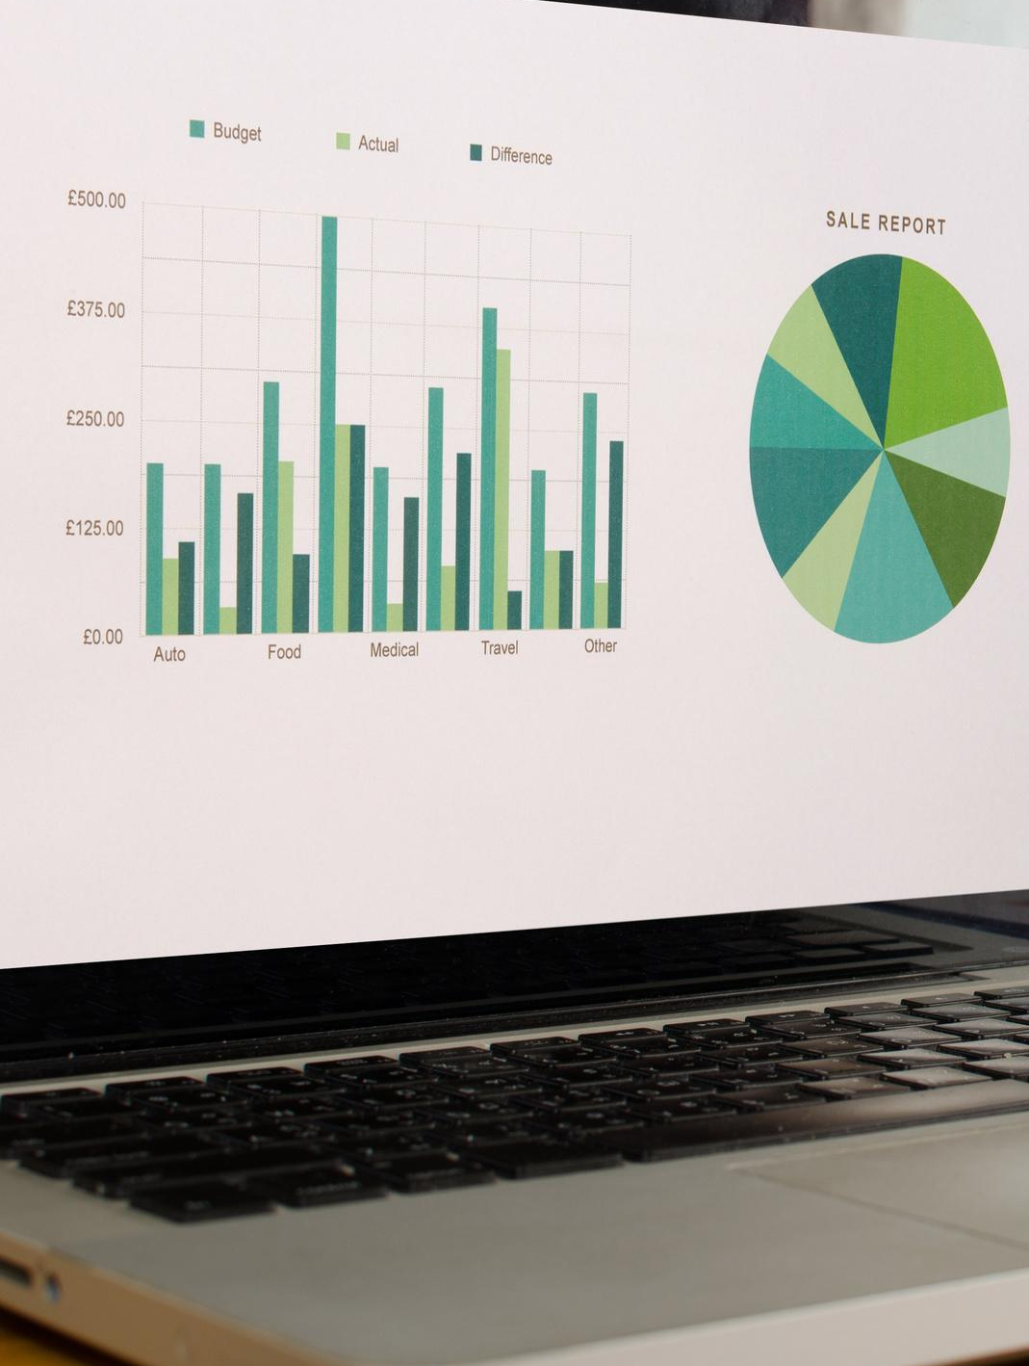

Our Important Values
What are the values of your company that you promise to your customers.
Increase in customers
Decrease in money marketing

Slide 6

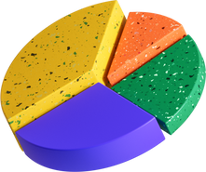
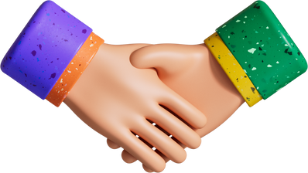


Service Introduction
Digital Marketing
Social Media Managing
Affiliate Marketing

Slide 7
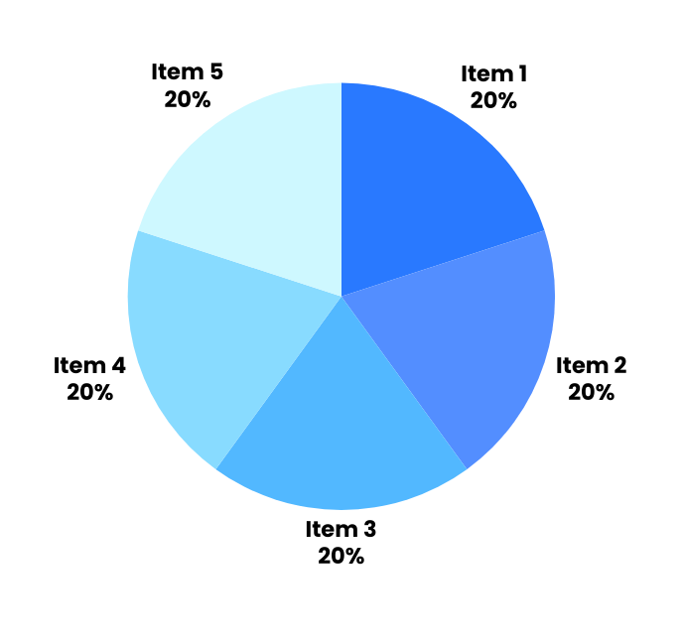

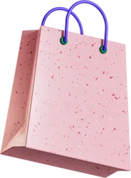

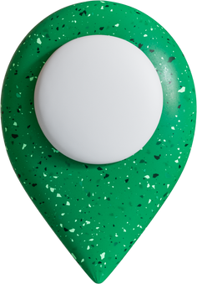

Key Trends
Gender of your audience
Shopping interest
Other Factors
Demographic
Interest of the audience

Slide 8
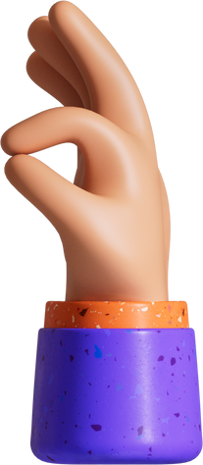

Satisfaction Factors
Level 3
Affordable
Level 2
Level 1
Experience
Quality

Slide 9




Expected Growth
Growth
Increase in number of products
Increase in profit
Customer satisfaction and reviews.
Time(yrs)

Slide 10

81%
January
79%
February
Data Analysis
92%
March
The complete data for the whole year of 2022.
69%
April
95%
April

Slide 11

Business Strategy
Plan
Plan
Proper planning of all the goals according to the months
Adapt
Adapt and improve
Adapt the plan, measure the progress and improve.
Improve

Slide 12

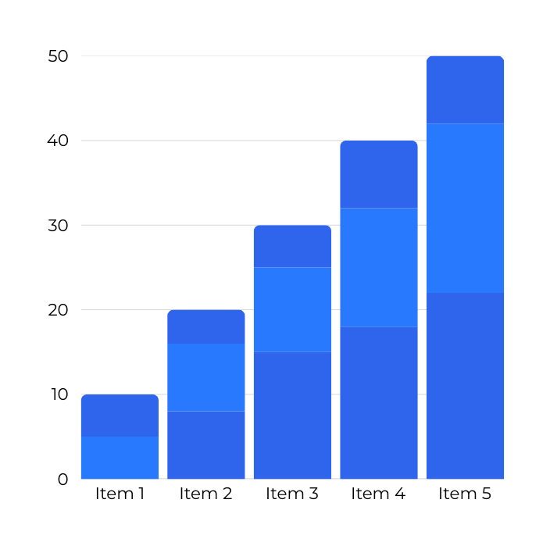
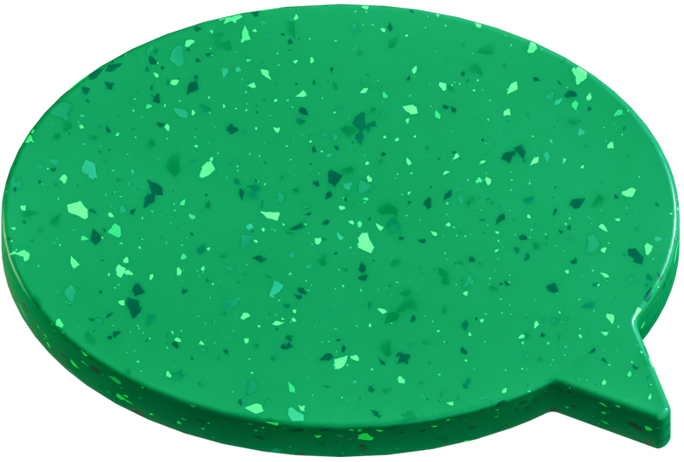
Revenue Chart
The revenue chart for the past three years with the current year.
50M
70M
Profit
Revenue

Slide 13
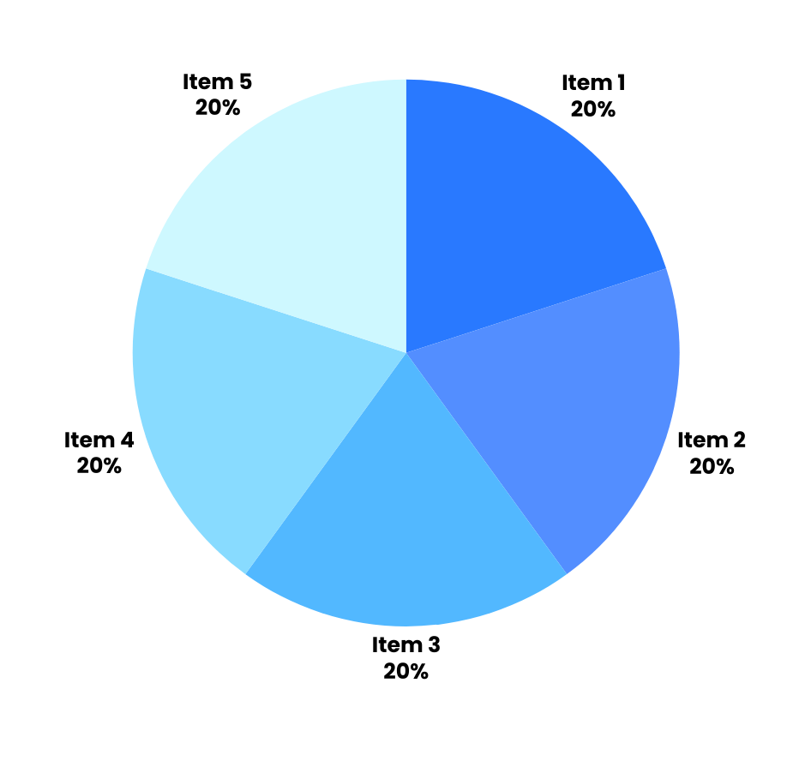
Funding Plan
89%
The funding will be received from investors
You funding plan and graphs will go here.

Slide 14

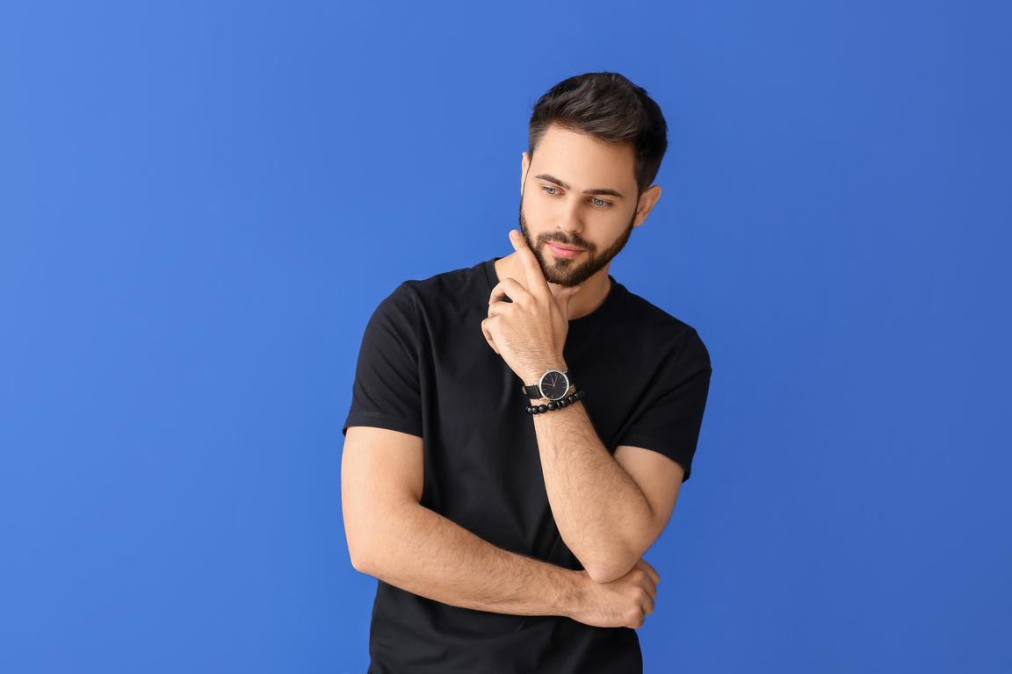

MEET THE TEAM
Sarah Sukanti
Almar Suni
Yani Santri
CEO
MARKETING
FINANCE

Slide 15




THANK YOU!
LOCATION
CALL
WEBSITE

