Slide 1




Prepared by group 1
GROUP
PROJECT
ENHANCING PRODUCT SALES STRATEGY
15 February, 2025

Slide 2





TEAM MEMBERS
DIANDRA PRATAMA
KRISNA PANGESTU
Leader
Member
PRAMESTI PUTRI
Member

Slide 3



INTRODUCTION
Our project aims to analyze, strategize, and implement techniques to boost product sales for Warner & Spencer. We recognize the importance of a robust sales strategy and intend to explore innovative methods to enhance sales figures and market penetration.

Slide 4





BACKGROUND PROJECT
CURRENT SCENARIO:
Warner & Spencer has been a significant player in its industry, offering various shampoo and soap products. While they've seen success, we acknowledge the evolving market dynamics and the need to adapt our sales strategies to maintain and increase our competitive edge.

Slide 5

CURRENT SALES TRENDS:
Over the past years, we've observed Warner & Spencer’s product sales going down because of some reason.
MARKET INSIGHTS:
Through comprehensive market analysis, we've identified shifts in consumer preferences, competitive landscape changes, and emerging market segments.
SALES PERFORMANCE ANALYSIS
CUSTOMER FEEDBACK:
Direct feedback from our customers has highlighted areas for improvement

Slide 6





PROJECT OBJECTIVES
ANALYSIS PHASE
STRATEGY DEVELOPMENT
IMPLEMENTATION PLAN
Conduct a comprehensive analysis of current sales performance, market trends, and consumer behavior.
Identify strengths, weaknesses, opportunities, and threats (SWOT analysis) in the existing sales strategy.
Brainstorm and devise new strategies to leverage strengths and opportunities.
Develop a multifaceted approach integrating marketing, sales promotions, and customer engagement.
Create a detailed timeline with specific milestones and responsibilities.
Determine key performance indicators (KPIs) to measure the success of the new strategies.

Slide 7

EXPECTED OUTCOMES
INCREASED SALES FIGURES:
Target a 25% increase in sales over the next years.
Measure success by tracking sales metrics and revenue growth.
IMPROVED CUSTOMER ENGAGEMENT:
Foster stronger relationships with customers through personalized engagement strategies.
Increase customer retention rates and loyalty.
ENHANCED MARKET REACH:
Expand market reach by tapping into new demographics or geographical regions.
Strengthen brand presence through effective marketing campaigns.

Slide 8

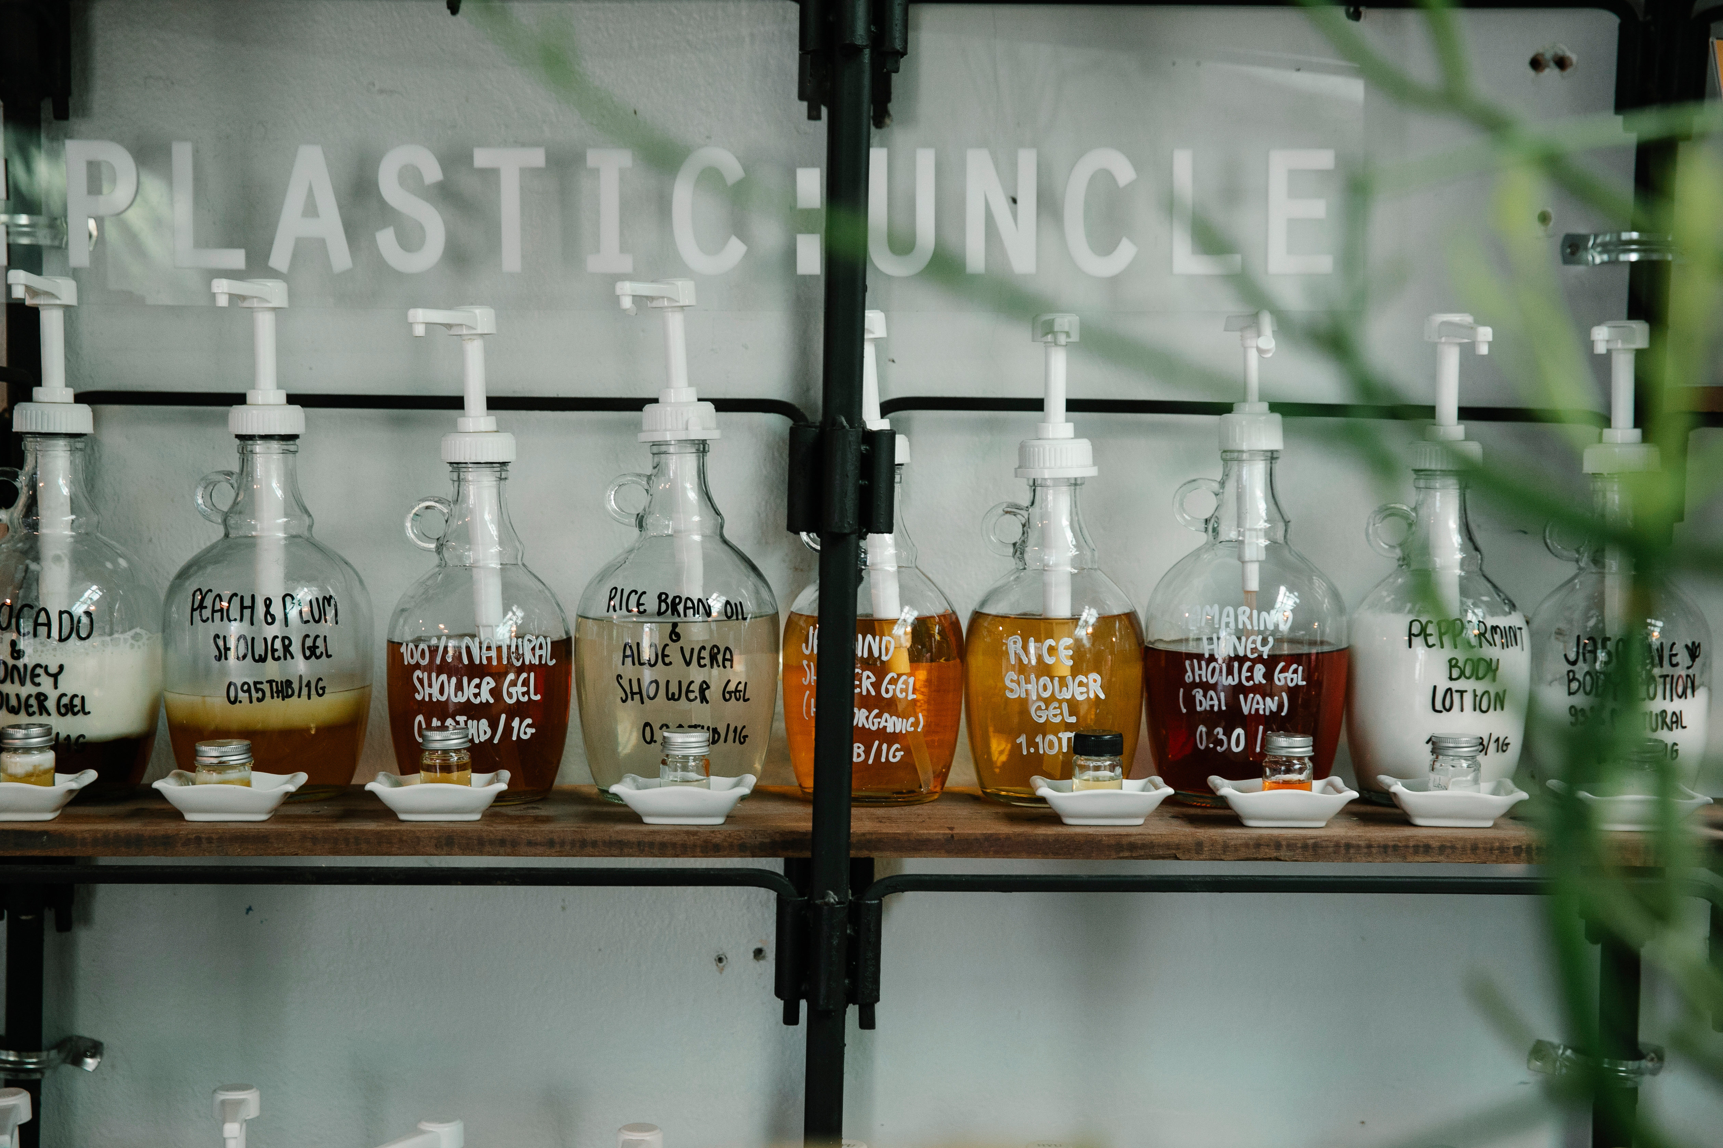

METHODOLOGY
DATA
COLLECTION:
BRAINSTORMING SESSIONS:
TESTING AND REFINEMENT:
Gather sales data, market research, and consumer feedback through surveys and analysis tools.
Utilize both primary and secondary research methods to gather comprehensive insights.
Collaborate to generate innovative ideas for product positioning, pricing, and promotional campaigns.
Consider various channels such as online platforms, partnerships, and offline marketing.
Pilot the proposed strategies on a smaller scale to assess their effectiveness.
Gather feedback, iterate, and refine the strategies based on initial results.

Slide 9
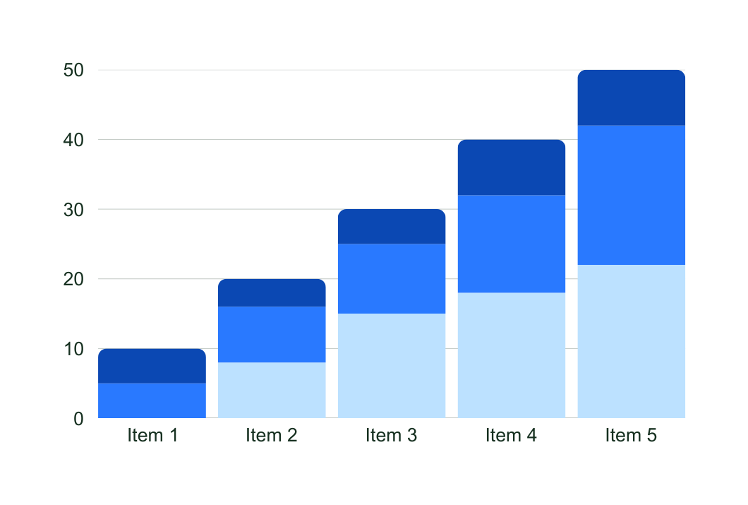

DATA
ANALYSIS
Over the past year, sales for Warner & Spencer have experienced a consistent decline, dropping month-on-month. The graphical representation of sales volumes reveals a noticeable downward trend, especially in the last quarter.

Slide 10
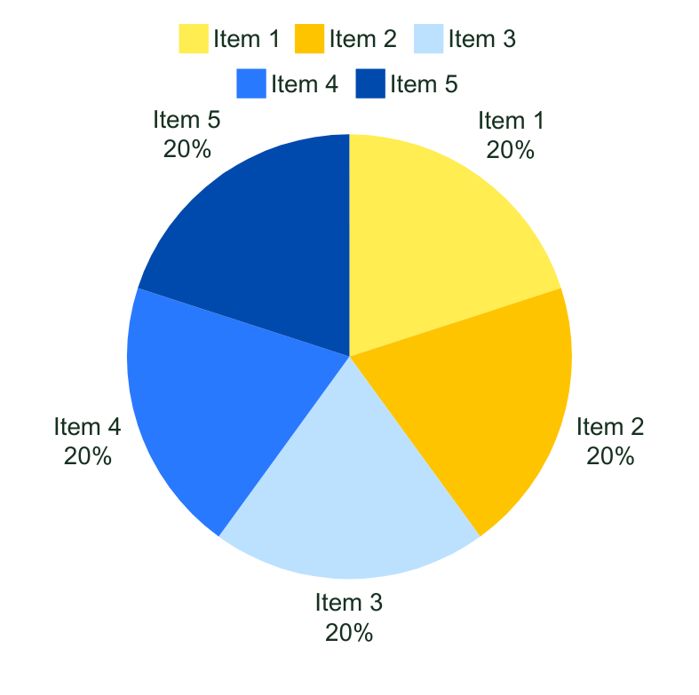
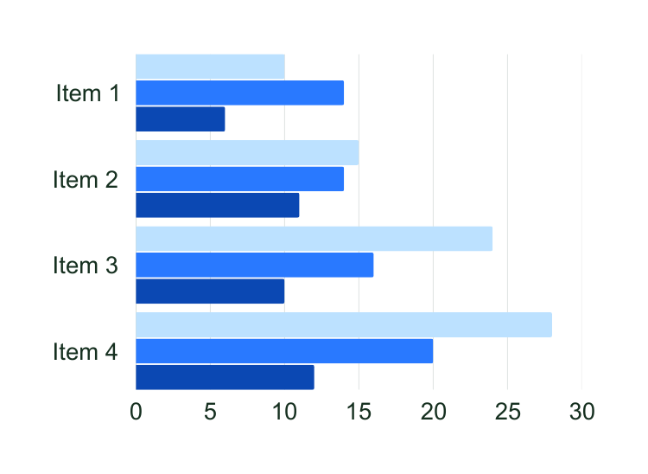
DATA ANALYSIS
Customer feedback reflects dissatisfaction with the recent changes in Warner & Spencer product’s packaging, possibly contributing to the decline. An analysis of competitor products reveals enhanced features and competitive pricing, overshadowing our Warner & Spencer product in the market.

Slide 11


CONCLUSION
By implementing a well-researched and innovative sales strategy, our goal is not only to boost immediate sales figures but also to establish a sustainable framework for continued growth and success.

Slide 12

Prepared by group 1
THANK
YOU
15 February, 2025

