Slide 1

CREATIVE ROADMAP
CREMATIVE
SENJA KOPI
RELAUNCH
TARGET AUDIENCE: PRESENTATION
SLIDE:
SENJA KOPI
Indian male shop owners
Chinese female marketing team
Pacific Islander male designers
TITLE
94-209

Slide 2

Relaunching a Local Coffee Shop
Brand: Senja Kopí
Objective:
Create a fresh and modern brand image,
and increase customer engagement,
and expand market reach
• Create a senjaa cofffee marke's coffie-shopt>
Senja Kopi engading popularity market kop: and
expanding clenter:..
Projectic Goal:
20% increase in sales within months
2%.00 nii sale within 6 months
Increase in sales of ik months
Increase of the roipulitar within 6 nonths

Slide 3
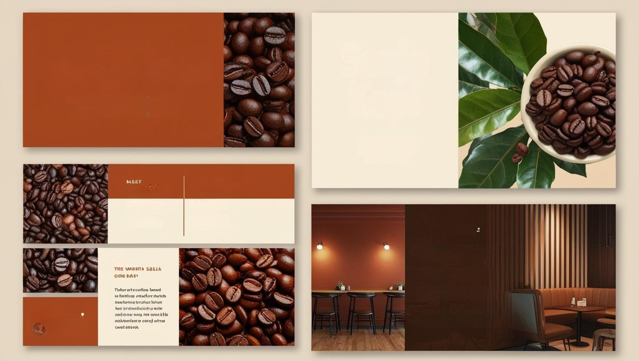
RELAUNCHING
Senja
Kopi
Senja Kopi
A LOCAL COFFFEE SHOP
BRAND IY S BRAND.
A wennt, Local
coffee concept
In the hend
MOOO OGRID
SOLELLET
ESEISVAMES
A Tale fogdo
& Foohro
3 Seatin Bran
Lheate
4 Poolte Boters
& Feherno Snutb
6 Tout ochon
STYLE
"The wamth
of Senja
in the hand"
THOME
Senja kopi
Godio Our Cofee Cofee trop
Illucottono io toy viheom ribe tere

Slide 4

Senija a
Local
local
coffee
PHASE 1
Phase 1: Research & Brainstorming
shop
brand
MAARVET
RESEARCH
-SENJIA
AN/ALYSIS
GO
Eominncerning
adn
CUSTOMER
COMPEITOR
INTEMIES
ANALYSIS
01
02
03
06
07
Ju sns
20
2011
AMY NAI
OK ID01
AN1 THS
OCT 3183
ANY NOS
Research & Brainstorming
01 Comprehmnive narket
analysis analyatis,
enpocrating explation of
Curont tucreme cofee
trends
03 Exploracing
immary of
curent icoffee
tredes trends
Q4 Detailled
cninner birand
concept
brainstorming
05 Refined
Erand concept
brainstormning
OZ Refnnle brand deal
Fimillerime egclovel ideas
and niiial mood board
brainstoming

Slide 5
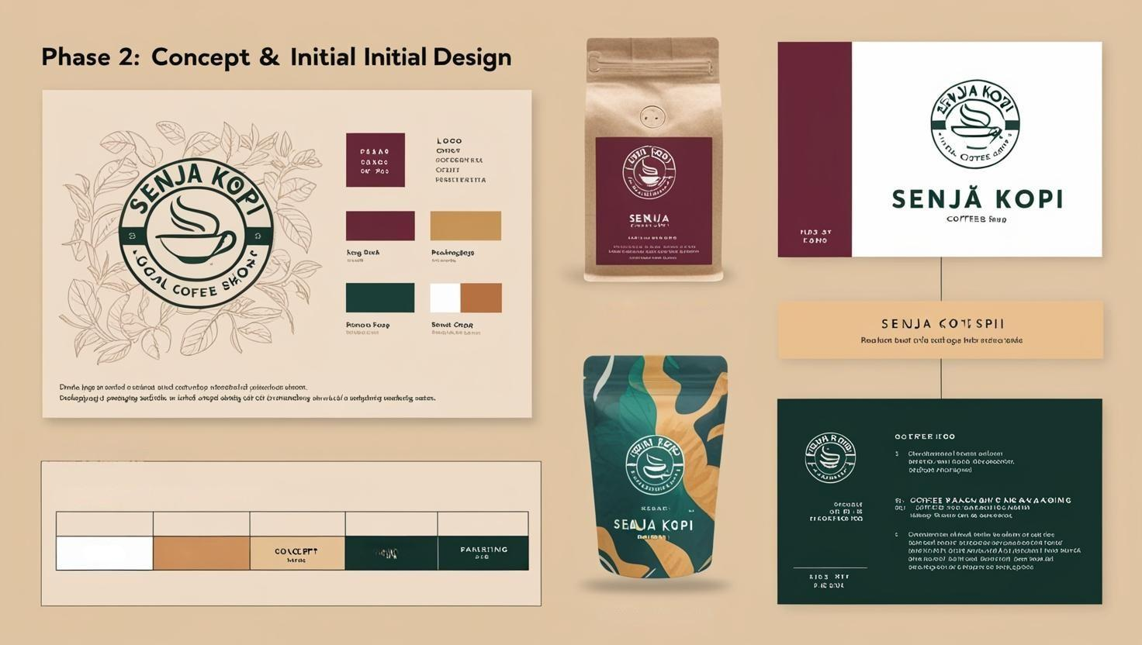
IMPLEMENTION TIME
Time Timeline
CONCEPTE & INITIAL DESIGN
PHASE
PIMASS 2
TIMMINERING
IMPLLIMEWATION TIME

Slide 6
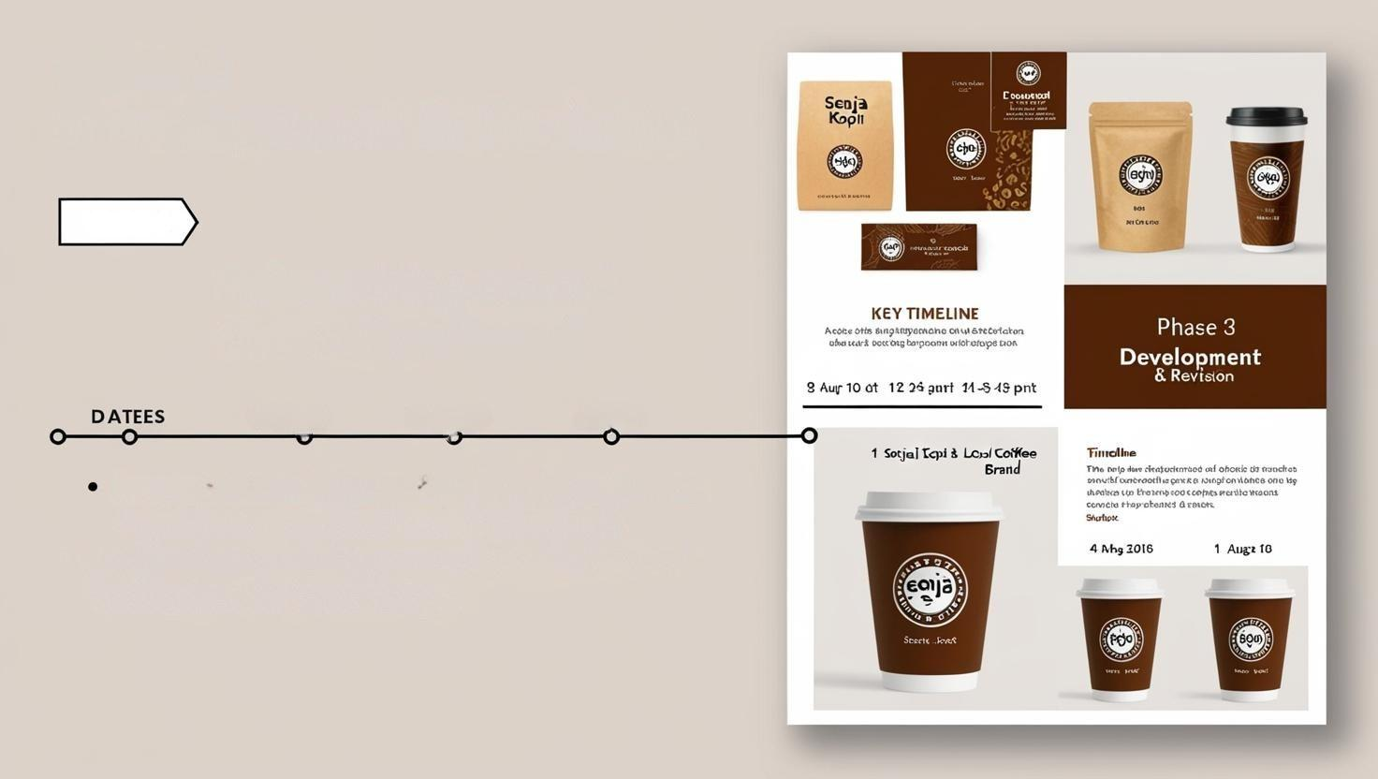
PHASE 3:
Development & Revision
SLIDE 6
Relaunching a Local
Coffe-Shop Brand
DTATES
DATERS
AFTER
Presentation of design to client/client/team,
+ revisions, + revisions based & feedback
• Finallization of the promotional noterials, and
finallization the brand design.

Slide 7
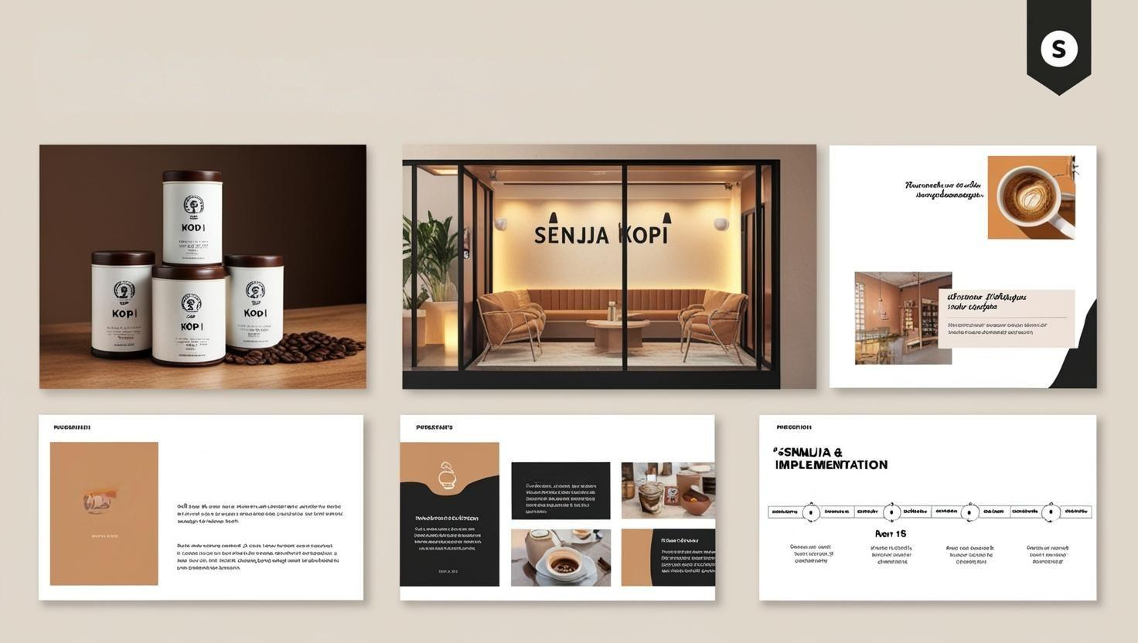
SLIDE 4
Phase 4: Production & Implementation
Reelaunching a Local Coffee Shop Shop Fic Brand: "Brand!"
20 DAME
TO 1000YER
Reolohing A Loocal
Coffee Shop Brand Launch
Colcaemethg Caripaleg
thank Gerne Soner
senja
Kopi
Nay 20
May 21
Moy 20

Slide 8
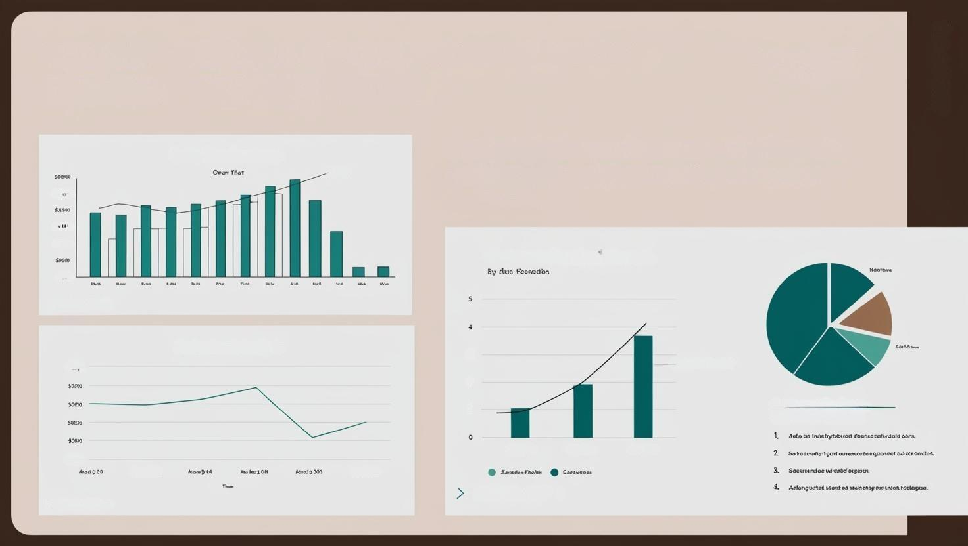
RELAUNCHING A LOCAL COFFEE SHOP
BRAND: SENJJJA KOPI
SENJA KOPÍ
Analyzing sales performance, social media
social media engagement, and custoner
feedback
Sales Performance
Degedeng
$3000
50000
$5000
Customer Feedback Growth
$300
> SENJA KOPI
Evaluation & Analyzis
3
$900
Cuschactor 1/rodocl
2
1
Cuckomer Feedback
Custivner Feaback
30630
Any 2015
My 2013
Cros 2013
A 403051
Fuar 200
> SENIJIA KOP I
> SELJA KOP |

