Slide 1





SWOT Analysis:
Evaluasi Pasar

Slide 2
Competitor Analysis
Competitor A
Competitor B
Competitor C
Competitor D
The internal capabilities, resources, and advantages that position the business for success.
The internal limitations or deficiencies that may hinder the organization's progress.
The external market conditions, trends, or circumstances that present favorable prospects for growth.
The external factors, obstacles or risks that have the potential to negatively impact the business.

Slide 3
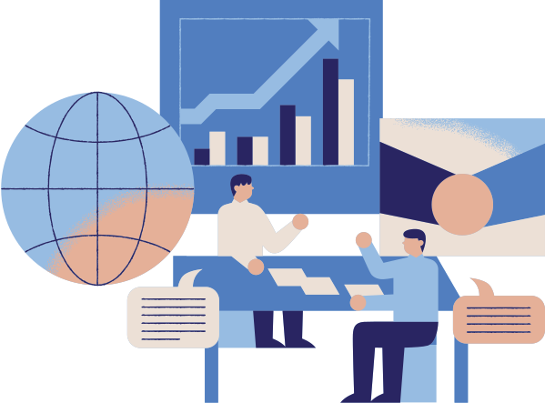

Internal Analisis
Evaluating Strengths and Weaknesses
01
Assess Resources
Evaluate your company's assets, skills, and capabilities.
02
Identify Advantages
Determine your key strengths and competitive advantages.
03
Uncover Limitations
Acknowledge your weaknesses and areas for improvement.

Slide 4
Eksternal Analisis
Identifying Opportunities and Threats
Identify Market Trends
01
Analyze the competitive landscape, customer demands, and industry shifts to uncover emerging opportunities.
Assess Technological Advancements
02
Explore how new technologies can create competitive advantages or disrupt your business model.
Examine Regulatory Changes
03
Stay informed about evolving laws and regulations that may impact your operations and compliance requirements.

Slide 5
Conducting a Comprehensive SWOT Analysis
Develop Strategies
Gather Data
Analyze Factors
Prioritize Insights
Collect comprehensive information about your internal strengths and weaknesses, as well as external opportunities and threats.
Carefully examine each element of the SWOT framework to understand its significance and impact on your business.
Identify the most critical factors that will drive your strategic decision- making and action planning.
Formulate strategies to leverage your strengths, address weaknesses, capitalize on opportunities, and mitigate threats.

Slide 6
Prioritizing
Factors and Developing Strategies
Prioritize by Impact
01
Assess the relative importance and potential impact of each SWOT factor. Focus on the most significant strengths, weaknesses, opportunities, and threats first.
Leverage Strengths
02
Identify ways to use your strengths to capitalize on opportunities and mitigate weaknesses. Develop strategies that build on your core competencies.
Address Weaknesses
03
Determine how to improve upon or compensate for your weaknesses, either by investing in skill development or finding alternative approaches.
Minimize Threats
04
Devise plans to proactively address external threats, whether by pursuing new markets, diversifying products, or strengthening your competitive position.

Slide 7
Leveraging Strengths to Capitalize on Opportunities
Allocate Resources Strategically
Identify Synergies
Collaborate and Partner
Innovate and Evolve
Examine how your company's core strengths can be used to seize promising market opportunities.
Focus your investment and efforts on the areas where your strengths provide the greatest competitive advantage.
Leverage your proven capabilities to develop new products, services or business models that capitalize on emerging trends.
Seek out strategic partnerships that allow you to combine your strengths with complementary capabilities of others.

Slide 8
Mitigating Weaknesses
and Overcoming Threats
Identify Weaknesses
01
Pinpoint areas where your organization is vulnerable or lacking the necessary capabilities.
Develop Strategies
02
Devise proactive measures to address and mitigate your identified weaknesses.
Monitor Threats
03
Continuously scan the external environment to identify emerging threats and trends.

Slide 9
Implementing SWOT-Driven Action Plans
Prioritize and Plan
Assign Responsibilities
Monitor and Adjust
Identify the most critical strengths, weaknesses, opportunities, and threats. Develop actionable strategies and set measurable goals to capitalize on strengths and opportunities.
Delegate tasks and responsibilities to the appropriate teams or individuals based on their skills and expertise. Ensure clear communication and accountability.
Regularly review progress, measure outcomes, and be prepared to adapt your plans as market conditions or internal factors change. Continuous improvement is key.

